Slide 1
Data Structures & Algorithms (CSC-214)
Linked List

Slide 2
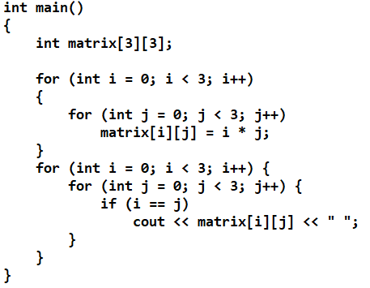
Q: Pointers

Slide 3
Q: Pointers
Notes:
Answer: 0 1 4

Slide 4
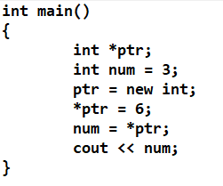
Q: Pointers
Notes:
Answer: 6

Slide 5
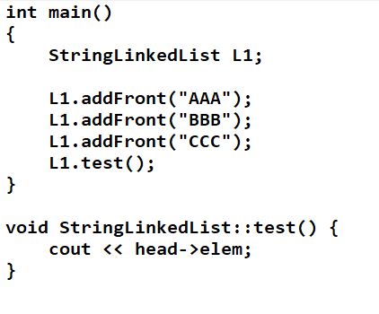
Q: Singly LL
Notes:
Answer: CCC

Slide 6
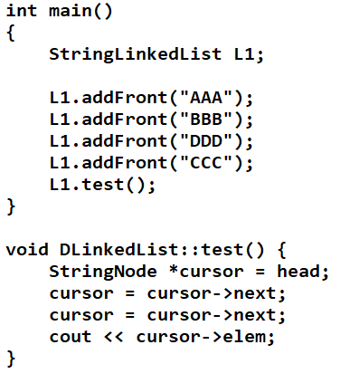
Q: Singly LL
Notes:
Answer: BBB

Slide 7
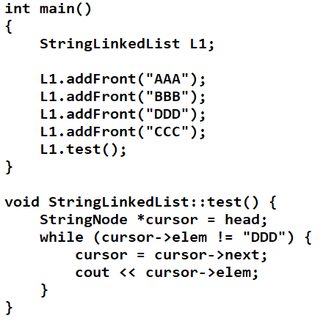
Q: Singly LL
Notes:
Answer: DDD

Slide 8
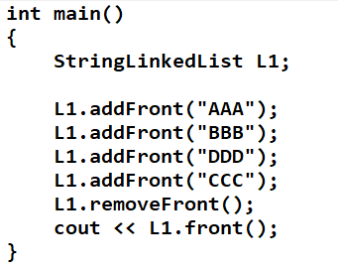
Q: Singly LL
Notes:
Answer: DDD

Slide 9
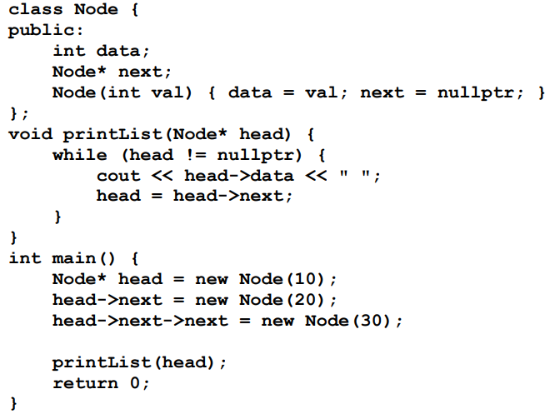
Q: Singly LL
Dry run
Notes:
Answer: 10 20 30

Slide 10
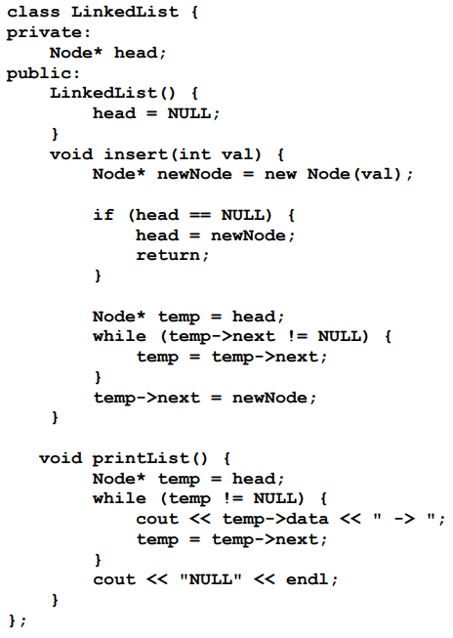
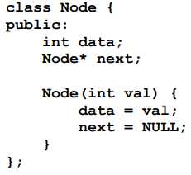
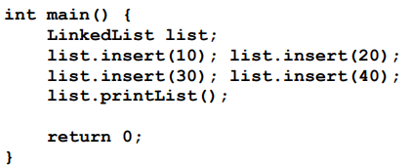
Q: Singly LL
Notes:
Answer: 10 -> 20 -> 30 -> 40 -> NULL

Slide 11
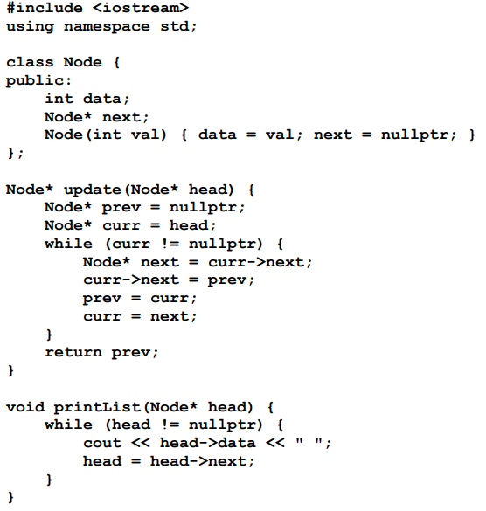
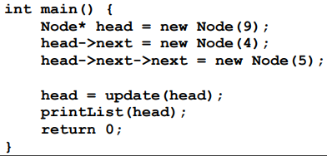
Q: Singly LL
Notes:
Answer: 5 4 9
//reverses the links in a singly linked list

Slide 12
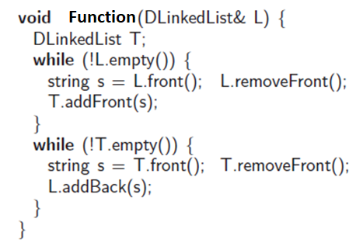
Q: Singly LL
What is the purpose of the following code?
Notes:
Reverses the list

Slide 13
Doubly Linked List Questions

Slide 14
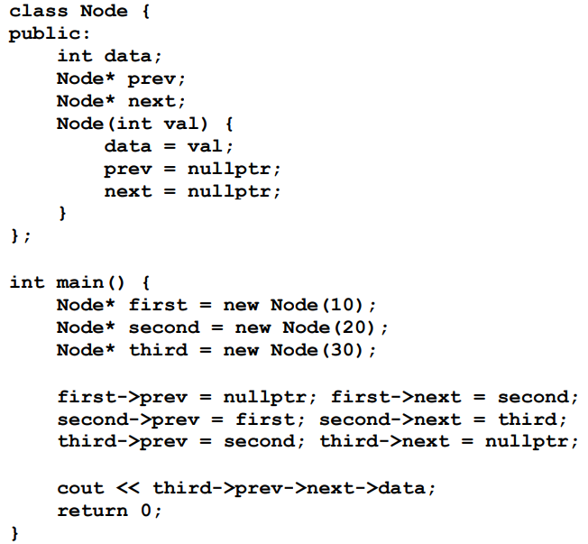
Q: Doubly LL
Dry run
Notes:
Answer: 30

Slide 15
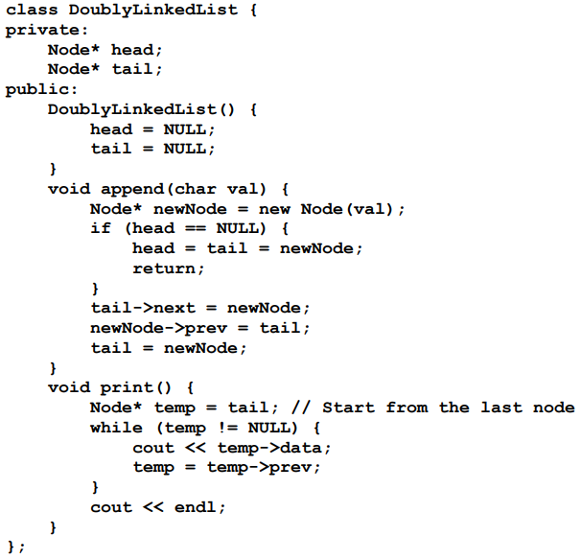
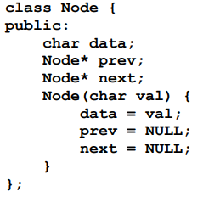
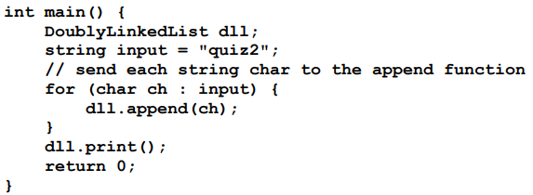
Q: Doubly LL
Notes:
Answer: 2ziuq

Slide 16
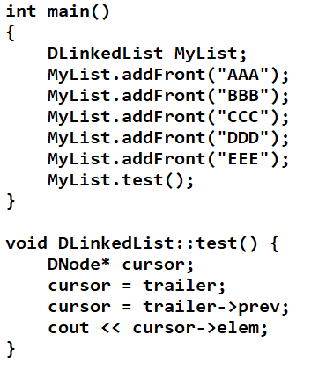
Q: Doubly LL

Slide 17
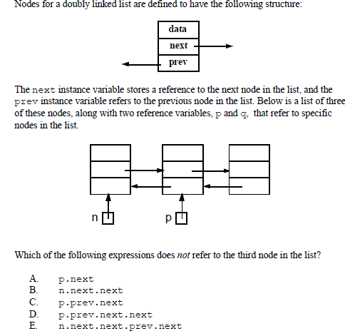
Q: Doubly LL
Notes:
Answer: C

Slide 18
Variations

Slide 19
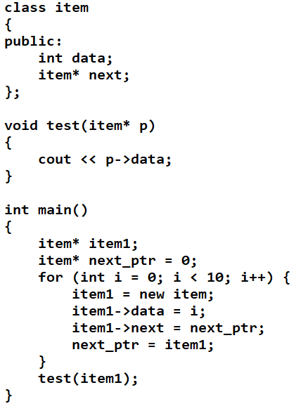
Determine output
Notes:
Answer: 9

Slide 20
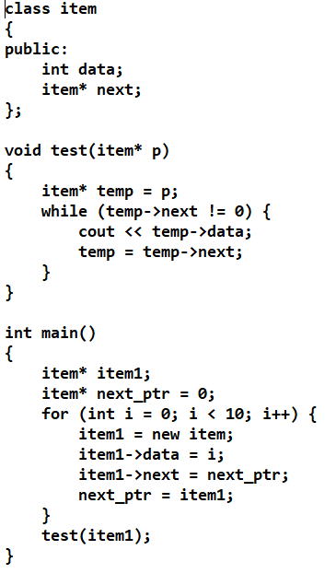
Determine output
Notes:
Answer: 987654321

Slide 21
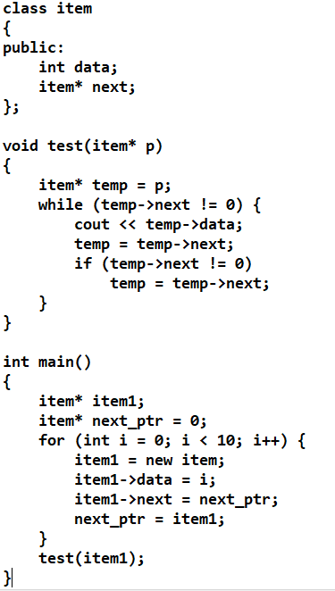
Determine output
Notes:
Answer: 97531

Slide 22
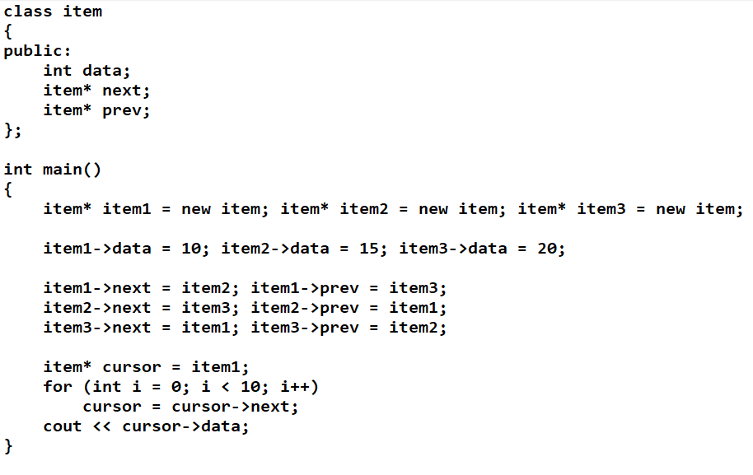
Determine output
Notes:
Answer: 15

Slide 23
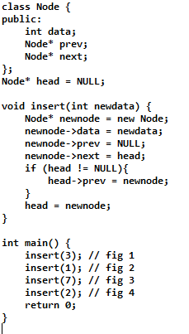
Draw the list created after each insert call in the space below (4 figures required)
Head
Notes:
Head
3
1,3
7,1,3
2,7,1,3

Slide 24
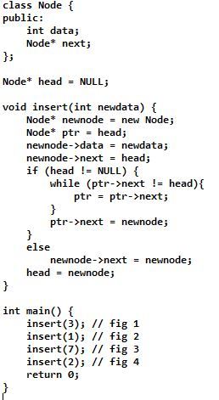
Draw the list created after each insert call in the space below (4 figures required)

Slide 25
Quiz practice

Slide 26
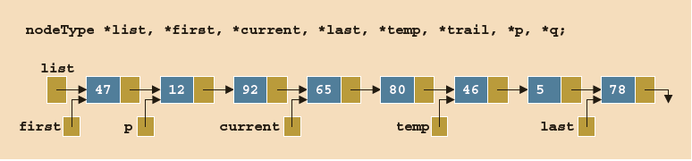
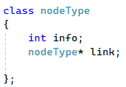
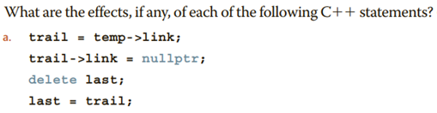
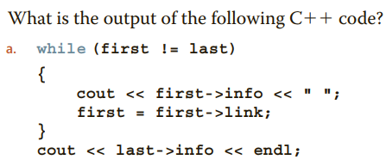
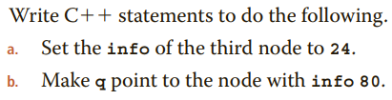
Question 1

Slide 27
Question 2
Complete the given code
Write codes (look up the provided complete codes for singly and doubly linked lists)

